Slide 1
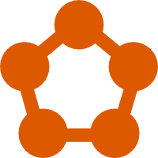
SERVICE FABRIC
Hands-On

Slide 2


Simon Dale
“I'm a Technical Architect with BJSS currently working on Microsoft Azure, Service Fabric and Mixed Reality with the .NET tech stack. I’ve always had an interest for distributed computing, data and producing scalable, performant software.”
@simondale_
https://github.com/simondale
https://linkedin.com/in/simonjdale

Slide 3


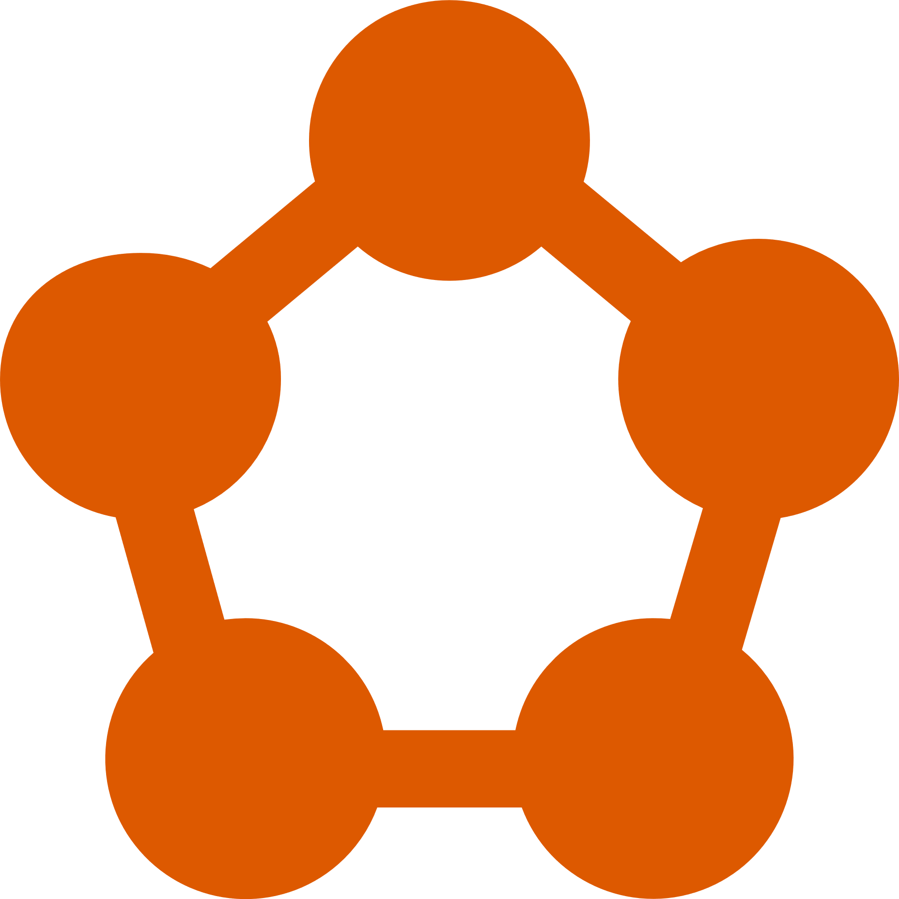
SERVICE FABRIC
Reliable Scalable Applications
Distributed Systems Platform
Scalable, Reliable Microservices and Containers
Next Generation, Enterprise Class, Cloud Scale
Application Platform Layer
Runs on a cluster of machines
Run anywhere
Hosting & Activation
Management Subsystem
Communication Subsystem
@simondale_
https://github.com/simondale/service-fabric-workshop

Slide 4




SERVICE APPROACH
State lives in compute tier
Low latency reads and writes
Partitions for horizontal scale
Data stores for analytics and DR
Stateless
State lives in compute tier
Low latency reads and writes
Partitions for horizontal scale
Data stores for analytics and DR
Stateful
State lives within actor instances
Massively scalable, low overhead
Synchronised concurrency
Out of box messaging
Reliable Actors
Containers
Reuse existing applications
Lightweight process execution
Maximise compute density
Benefit from placement and scale
Encapsulate key dependencies
Reuse existing estate
Additional isolation from host
Benefit from placement and scale
Guest EXE
@simondale_
https://github.com/simondale/service-fabric-workshop

Slide 5














POWERING AZURE SERVICES
SQL Database
Azure Core Services
Power BI
MySQL Database
Azure Container Registry
CosmosDB
IoT Hub
Stream Analytics
Event Hub
Azure DevOps
Dynamics
Cortana
Azure Monitor
Event Grid
@simondale_
https://github.com/simondale/service-fabric-workshop

Slide 6




APPLICATION
Web Application
Stateless Service
Basket API
Stateless Service
Products API
Stateless Service
Basket Actor
Reliable Actor
{ }
Mongo Database
Guest Executable
Orders API
Stateful Service
@simondale_
https://github.com/simondale/service-fabric-workshop
Notes:
https://github.com/simondale/service-fabric-workshop

Slide 7
DEPLOYMENT
Application
Products
Orders
Basket
Database
Web
Stateless Service
Product API
Stateless Service
Orders API
Stateful Service
Basket API
Stateless Service
Basket Actor
Reliable Actor
Mongo
Guest Executable
Code
Code
Code
Code
Code
Code
Config
Config
Config
Config
Config
Config
Data
Data
Data
Data
Data
Data
State Manager
State Manager
Reliable Dictionary
Reliable Queue
@simondale_
https://github.com/simondale/service-fabric-workshop
Notes:
https://github.com/simondale/service-fabric-workshop

Slide 8

WORKSHOP
Application
v1.0.0
Application
v2.0.0
Application
v3.0.0
Products
v1.0.0
Basket
v1.0.0
Orders
v1.0.0
Service
Fabric
Database
v1.0.0
database
products
application
basket
orders
Branches
@simondale_
https://github.com/simondale/service-fabric-workshop
Notes:
https://github.com/simondale/service-fabric-workshop

Slide 9
PREREQUISITES
Visual Studio Code or Community Edition
https://visualstudio.microsoft.com
https://code.visualstudio.com
Service Fabric SDK
https://www.microsoft.com/web/handlers/webpi.ashx?command=getinstallerredirect&appid=MicrosoftAzure-ServiceFabric-CoreSDK
Azure Subscription
https://portal.azure.com
Azure DevOps Account
https://dev.azure.com
@simondale_
https://github.com/simondale/service-fabric-workshop

Slide 10
DATABASE GUEST EXECUTABLE
$ git checkout database
MongoDB
Guest executable (mongod)
Test deployment using client (mongo)
Roadmap to replace this service with Azure PaaS (CosmosDB)
@simondale_
https://github.com/simondale/service-fabric-workshop

Slide 11
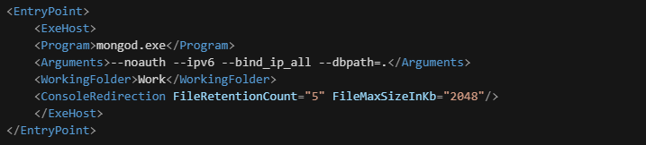
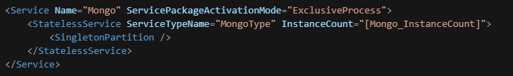
DATABASE GUEST EXECUTABLE
Service Manifest
Defines the Guest Executable service
Specify the entry point program
Optional command line arguments
Working folder
Capture log files and setup log file rotation
Application Manifest
Define parameters for configurable service scalability
Setup a partitioning strategy
Specify number of instances per partition
The Database application is a singleton with a single instance
@simondale_
https://github.com/simondale/service-fabric-workshop

Slide 12
STATELESS PRODUCTS WEB API
$ git checkout products
ASP.NET MVC WebAPI
Single controller (Products)
MongoDB repository for CRUD operations
Settings containing connection details
Test using curl or PowerShell
@simondale_
https://github.com/simondale/service-fabric-workshop

Slide 13
STATELESS APPLICATION
$ git checkout application
ASP.NET MVC Web Front-End
Implement a single controller for Products
Support CRUD operations
Link to Product API microservice
@simondale_
https://github.com/simondale/service-fabric-workshop

Slide 14
BASKET RELIABLE ACTORS
$ git checkout basket
ASP.NET MVC WebAPI
Service Fabric Reliable Actor
Calls to API request Actor Proxy and issue requests
Reliable actors maintain state linked to user session
Expiry timeout for actors
Update Web Application to add items to Basket
@simondale_
https://github.com/simondale/service-fabric-workshop

Slide 15
STATEFUL ORDER SERVICE
$ git checkout order-processing
ASP.NET MVC WebAPI
Stateful Service
Support competing consumers through Reliable Queue
Persist order details and statistics to MongoDB
Maintain current statistics in Reliable Dictionary
@simondale_
https://github.com/simondale/service-fabric-workshop

Slide 16
BUILD IN AZURE
$ . src/scripts/deploy-azure.sh
Fully Managed Cluster
Azure Portal Integration
Azure Resource Manager
Auto-scaling
Integration with Azure Infrastructure
@simondale_
https://github.com/simondale/service-fabric-workshop

Slide 17
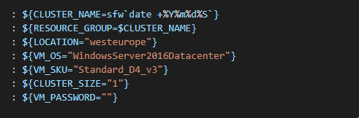
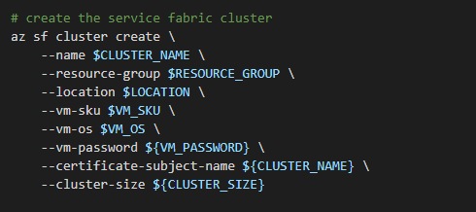
BUILD IN AZURE
Define Variables
Cluster name must be globally unique (e.g. date suffix)
Support for Linux or Windows OS
Different VM SKU available for different workloads
Configurable cluster size
Securely set a VM password
Deploy Cluster
AZCLI will create:
Service Fabric Cluster
KeyVault for certificates and secrets
Virtual Machine Scale Set for Auto-Scale
Virtual Network (including IP, VNET, LB and NSG)
@simondale_
https://github.com/simondale/service-fabric-workshop

Slide 18


AZURE DEVOPS INTEGRATION
Login to https://dev.azure.com
Create a new team project
Ensure git source control provider
Create a repository
Import existing code from github
https://github.com/simondale/service-fabric-workshop
Create build pipeline
Select Service Fabric Build template
Add task for each application in repository
Enable continuous integration
Create release pipeline for the build
Select Service Fabric Deploy template
Add task for each artefact in drop
Configure variables and parameter overrides
@simondale_
https://github.com/simondale/service-fabric-workshop

Slide 19
LOOKING BACK
What/why/how of Service Fabric
Service types and deployment
Built a sample application
Pipelines with Azure DevOps
Continuous integration
{ }
@simondale_
https://github.com/simondale/service-fabric-workshop
Notes:
https://github.com/simondale/service-fabric-workshop

Slide 20
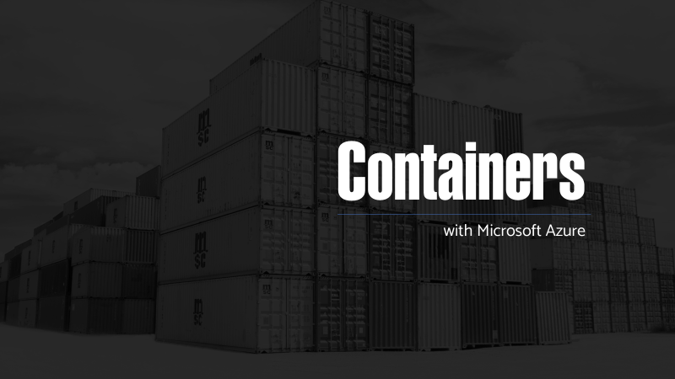



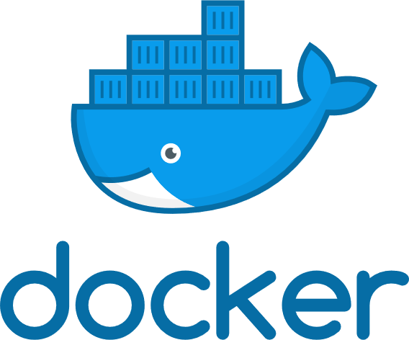
WHAT’S NEXT
Azure Containers @dotnetnotts
What / Why / How
Docker, DockerHub
PaaS services with Azure
Continuous Integration
Service Fabric Mesh
@simondale_
https://github.com/simondale/azure-containers
Notes:
https://github.com/simondale/service-fabric-workshop

